Slide 1
Introduction to Unit Testing

Slide 2
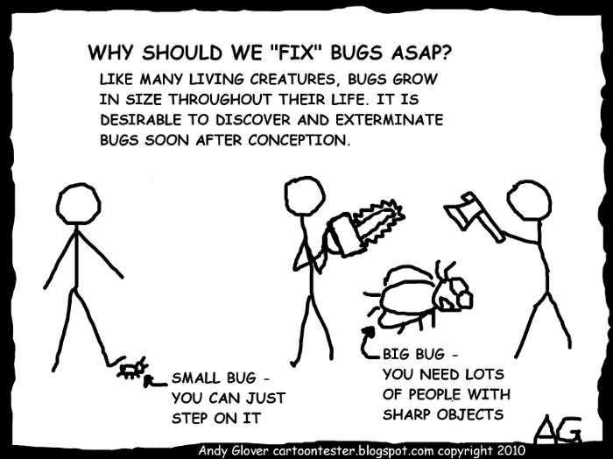
Cost of Defect Fixing

Slide 3
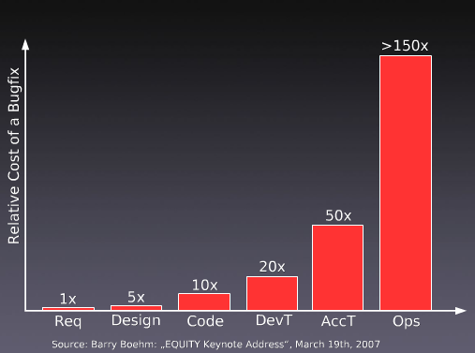
Cost of Defect Fixing

Slide 4
Test Types
Unit testing
Tests an atomic unit of code
Integration testing
Tests two or more modules as a group
User acceptance testing
Tests performed by end users to validate specific features
BDD test
Look like a unit test, feels like an user acceptance test

Slide 5
Definition
A unit test is an automated piece of code that invokes a unit of work in the system and and then checks some assumptions about the behavior of that unit of work.
A unit of work is a single logical functional use case in the system that can be invoked by some public interface (in most cases). A unit of work can span a single method, a whole class or multiple classes working together to achieve one single logical purpose that can be verified.
The Art of Unit Testing by Roy Osherove

Slide 6
Characteristics
Able to be fully automated
Has full control over all the pieces running (Use mocks or stubs to achieve this isolation when needed)
Can be run in any order if part of many other tests
Runs in memory (no DB or File access, for example)
Consistently returns the same result (You always run the same test, so no random numbers, for example)
Runs fast
Tests a single logical concept in the system
Readable
Maintainable
Trustworthy (when you see its result, you don’t need to debug the code just to be sure)

Slide 7
Traditional testing vs. Unit testing

Slide 8
Traditional Testing
Test the system as a whole
Individual components rarely tested
Errors go undetected
Isolation of errors difficult to track down
Strategies:
Print statements
Use of Debugger
Debugger Expressions
Test scripts

Slide 9
Unit Testing
Each part tested individually
All components tested at least once
Errors detected earlier
Smaller scope, easier to fix errors

Slide 10
Why Unit Tests
Faster Debugging
Faster Development
Better Design
Excellent Regression Tool
Reduce Future Cost

Slide 11
Benefits
Unit testing allows the programmer to refactor code at a later date, and make sure the module still works correctly.
By testing the parts of a program first and then testing the sum of its parts, integration testing becomes much easier.
Unit testing provides a sort of living documentation of the system.

Slide 12
Guidelines

Slide 13
Guidelines
Keep unit tests small and fast
Ideally the entire test suite should be executed before every code check in. Keeping the tests fast reduce the development turnaround time.
Unit tests should be fully automated and non-interactive
The test suite is normally executed on a regular basis and must be fully automated to be useful. If the results require manual inspection the tests are not proper unit tests.
Make unit tests simple to run
Configure the development environment so that single tests and test suites can be run by a single command or a one button click.
Measure the tests
Apply coverage analysis to the test runs so that it is possible to read the exact execution coverage and investigate which parts of the code is executed and not.

Slide 14
Guidelines
Fix failing tests immediately
Each developer should be responsible for making sure a new test runs successfully upon check in, and that all existing tests runs successfully upon code check in. If a test fails as part of a regular test execution the entire team should drop what they are currently doing and make sure the problem gets fixed.
Keep testing at unit level
Unit testing is about testing classes. There should be one test class per ordinary class and the class behaviour should be tested in isolation. Avoid the temptation to test an entire work-flow using a unit testing framework, as such tests are slow and hard to maintain. Work-flow testing may have its place, but it is not unit testing and it must be set up and executed independently.

Slide 15
Guidelines
Start off simple
One simple test is infinitely better than no tests at all. A simple test class will establish the target class test framework, it will verify the presence and correctness of both the build environment, the unit testing environment, the execution environment and the coverage analysis tool, and it will prove that the target class is part of the assembly and that it can be accessed.
Keep tests independent
To ensure testing robustness and simplify maintenance, tests should never rely on other tests nor should they depend on the ordering in which tests are executed.
Name tests properly
Make sure each test method test one distinct feature of the class being tested and name the test methods accordingly. The typical naming convention is Test[what] such As TestSaveAs(), TestAddListener(), TestDeleteProperty() etc.

Slide 16
Guidelines
Test public API
Unit testing can be defined as testing classes through their public API. Some testing tools makes it possible to test private content of a class, but this should be avoided as it makes the test more verbose and much harder to maintain. If there is private content that seems to need explicit testing, consider refactoring it into public methods in utility classes instead. But do this to improve the general design, not to aid testing.
Provide negative tests
Negative tests intentionally misuse the code and verify robustness and appropriate error handling.
Design code with testing in mind
Writing and maintaining unit tests are costly, and minimizing public API and reducing complexity in the code are ways to reduce this cost and make high-coverage test code faster to write and easier to maintain.

Slide 17
Guidelines
Don't connect to predefined external resources
Unit tests should be written without explicit knowledge of the environment context in which they are executed so that they can be run anywhere at anytime. In order to provide required resources for a test these resources should instead be made available by the test itself.
Write tests to reproduce bugs
When a bug is reported, write a test to reproduce the bug (i.e. a failing test) and use this test as a success criteria when fixing the code.
Know the limitations
Unit tests can never prove the correctness of code.

Slide 18
Guidelines
Test public API
Unit testing can be defined as testing classes through their public API. Some testing tools makes it possible to test private content of a class, but this should be avoided as it makes the test more verbose and much harder to maintain. If there is private content that seems to need explicit testing, consider refactoring it into public methods in utility classes instead. But do this to improve the general design, not to aid testing.
Provide negative tests
Negative tests intentionally misuse the code and verify robustness and appropriate error handling.
Design code with testing in mind
Writing and maintaining unit tests are costly, and minimizing public API and reducing complexity in the code are ways to reduce this cost and make high-coverage test code faster to write and easier to maintain.

Slide 19
Test Driven Development

Slide 20
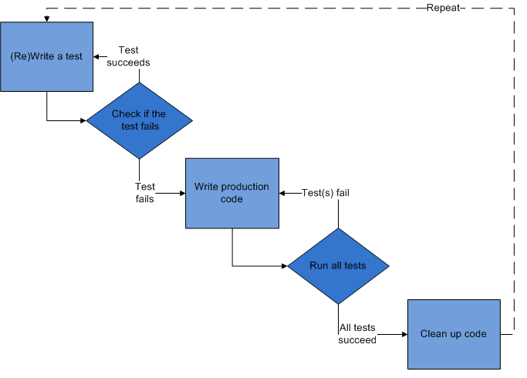
Test Driven Development
Notes:
Encourages simple design and inspires confidence

Slide 21
Technical Reasons for TDD
Test encourage better design sooner
Tests are the best documentation
Tests are your safety net
Every day use (immediate feedback)
Major refactoring freedom
Increase in development time (15 - 35%)
Decrease in pre-release defects (40 - 90%)
(source NCSU http://collaboration.csc.ncsu.edu/laurie/Papers/TDDpaperv8.pdf, Microsoft http://research.microsoft.com/en-us/groups/ese/nagappan_tdd.pdf)

Slide 22
TDD Example
Showcase

